Slide 1

Java course
-8-

Slide 2
8.Spring boot

Slide 3

What is a Spring Boot?
All in all, Spring Boot is a project built on the top of the Spring framework. It provides a simpler and faster way to set up, configure, and run both simple and web-based applications.

Slide 4
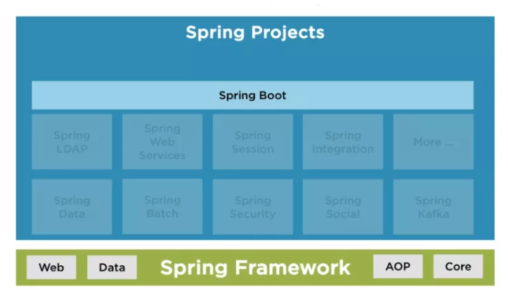
Spring Boot Architecture

Slide 5
Spring Boot Features
Auto-configuration: It sets up your application based on the surrounding environment, as well as hints what the developers provide.
Standalone: Literally, it's completely standalone. Hence, you don’t need to deploy your application to a web server or any special environment. Your only task is to click on the button or give out the run command, and it will start.
Opinionated: This means that the framework chooses how to things for itself. This is the point where a lot of people says "wait a minute, I do not want to participate in it." Here I encourage you to wait for a second and hold your judgment for now, because, actually, it can be a good thing.

Slide 6
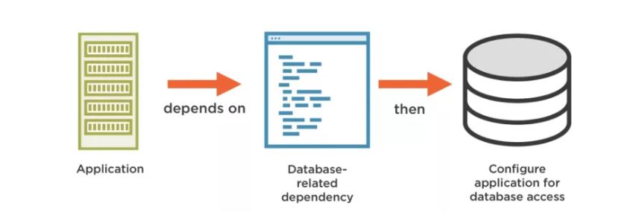
Data Access

Slide 7
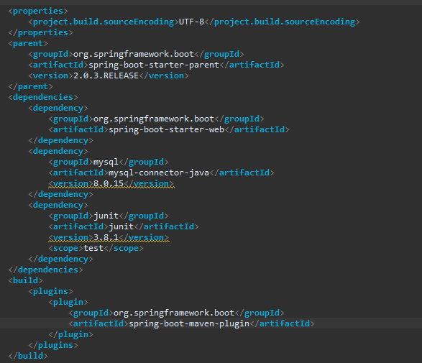
Creating a spring boot project
Create a new Maven Project and open pom.xml

Slide 8
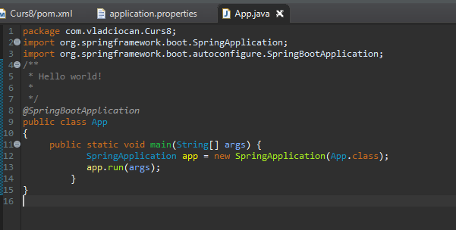
SBA Main Class

Slide 9
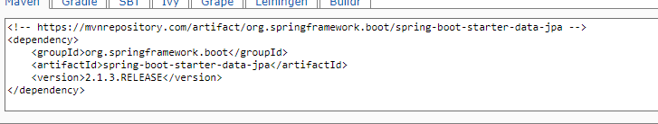
Adding DB connection (DataSource)

Slide 10
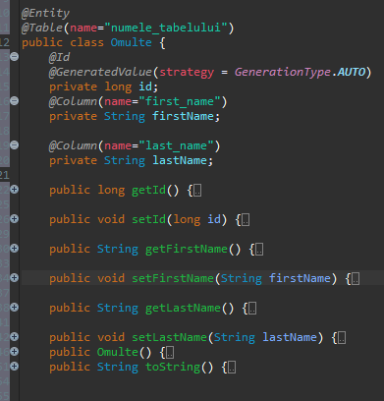
Create an entity

Slide 11
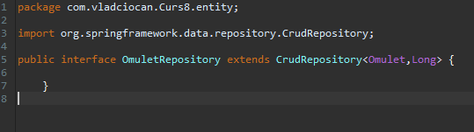
Create an Interface to handle entity

Slide 12
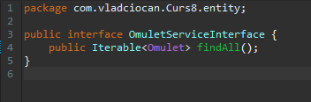
Create a Service Interface

Slide 13
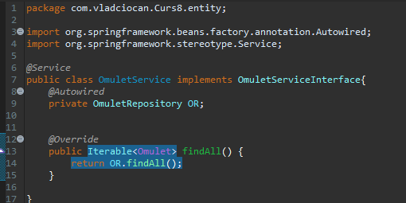
Implement the Service Interface

Slide 14
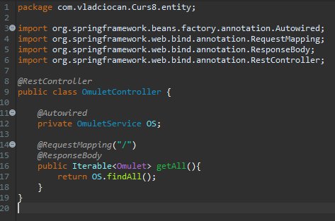
Create a controller

Slide 15
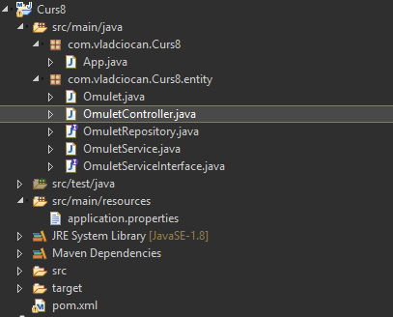
Done.

Slide 16
Finishing touch
-Update maven project
-Right Click -> Run as ->Java Application

Slide 17
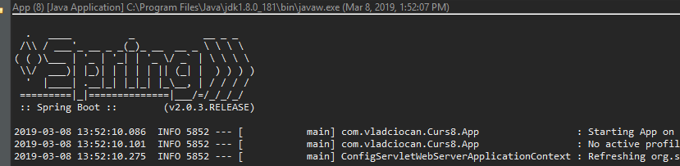
Run as Java Application

Slide 18
That`s it for today
Session review
-You learned Spring Boot
-You learned about DataSorces
-You learned annotations
GOOD JOB! ☺

